Slide 1

Best Social Media Management Software

Slide 2

WHAT ARE THE NAMES OF THESE SOCIAL NETWORKS?
https://create.kahoot.it/my-library/kahoots/08aa4a49-f9e6-451d-abad-afe0bb8802f9

Slide 3

Pre_Reading: Best Social Media Management Software
Let’s see what we know, think about…
1.What are the most popular social media?
2.Do you think social Media is used for marketing? Why
3.What kind of social media management platforms do you know?
4 What are their pros and cons?

Slide 4
Pre Reading activity
What I would like to know about social media management tools.

Slide 5
Let’s skim
Find the following information:
How many paragraphs does the passage have?
What are the topics covered, check the headings
Read the first two lines from each paragraph
Read the last two lines from each paragraph

Slide 6
FIRST PART OF THE TEXT:
Start Reading the first part of the text.
It starts with: Recent figures show that around 63% of small businesses
And stops in the headline: Loomly

Slide 7

Let’s read
It’s time to practice some skimming and scanning.
Let’s read the first part:
https://www.investopedia.com/best-social-media-management-software-5087716

Slide 8
Let’s scan
Why does the text talk about…….
63% of small business
an absolute nightmare
longest free trials in the business.
competitive benchmarking
all-in-one tool consumers

Slide 9
While reading practice
https://quizizz.com/admin/quiz/60bfda655b3404001b294c9a/best-social-media-management-software
Let’s practice more…
https://wordwall.net/es/resource/17497260
Capítulo 2
Introducción al tema
Notes:
Ask them to write their answers in the chat

Slide 10
Second part of the text second week
It starts in Loomy…..

Slide 11
Pre-reading
Fill in the W
Write what you KNOW about MEETEDGAR,LOOMLY,SENDIBLE,BUFFER,SOCIALPILOT
After you read the second part of the text what have you LEARNED.

Slide 12
While Reading….
Use the following didactic activities to check your understanding.
https://wordwall.net/es/resource/17498822

Slide 13
Post reading activity
What I wanted to know | What I learned

Slide 14
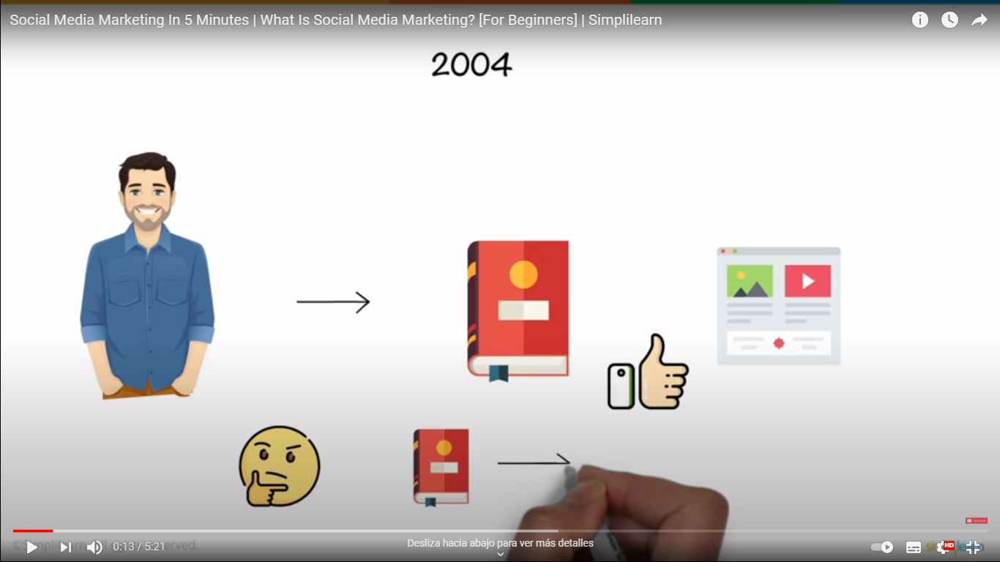
Let’s know more…
Click on the following video and write 5 ideas about it.
https://www.youtube.com/watch?v=I2pwcAVonKI

